Slide 1
PANIMALAR ENGINEERING COLLEGE DEPARTMENT OF CSE SIGN LANGUAGE RECOGNITION USING IMAGE BASED HAND GESTURE RECOGNITION TECHNIQUE
TEAM MEMBERS:
SARATH KUMAR U 211420104246
THARANI T 211420104287
THIRUGNANAM B 211420104290
GUIDE NAME:
MRS. V. ANITHA MOSES
ASSOCIATE PROFESSOR

Slide 2
BASE PAPER:
TITLE : Real-time Sign Language Recognition using Computer Vision
DOMAIN : Machine learning
AUTHOR : Jinalee Jayeshkumar Raval, Ruchi Gajjar
DESCRIPTION: This paper is an effort towards filling the gap between differently-abled people like deaf and dumb and the other people. Image processing combined with machine learning helped in forming a real-time system. Image processing is used for pre-processing the images and extracting different hand from the background. The Convolutional Neural Network proposed here is tested on both a custom-made dataset and also with real-time hand gestures performed by people of different skin tones. The accuracy obtained by the proposed algorithm is 83%.

Slide 3

ABSTRACT
The system focuses on efficient and accurate interpretation of sign language gestures for improved communication accessibility. Key components include image and video processing, feature extraction, and classification algorithms.
The model is trained on a diverse dataset of sign language gestures, enabling it to recognize and interpret a wide range of expressions.
The system demonstrates promising results in real-time applications, showcasing its potential to enhance communication for individuals with hearing impairments.

Slide 4
INTRODUCTION
Background and Significance:
Provide an overview of sign language and its importance for communication among the Deaf and hard-of-hearing communities.
Highlight the challenges faced by individuals who use sign language in a predominantly spoken language society.
Need for Sign Language Detection:
Explain the need for automated sign language detection systems, emphasizing the potential to bridge communication gaps between sign language users and non-signers.
Discuss scenarios where a sign language detection system could be beneficial, such as in educational settings, public spaces, or online communication platforms.
Current Limitations and Solutions:
Address the limitations of existing communication tools for sign language users, including the lack of real-time translation and accessibility.
Introduce the idea of using machine learning as a solution to improve the recognition and interpretation of sign language gestures.

Slide 5
EXISTING SYSTEM
Sign Language is one of the most reliable ways of communicating with people with special needs people, as it can be done anywhere. However most of the people do not understand sign language.
Deaf people have problems communicating with normal people in their daily lives. One reason for that is that not many people understand Sign Language (SL) . As such, this research aims to recognize hand gestures or SL, which the system will change into text that can be read in real-time, making communication with people with special needs easier.
Computer Vision and Pattern Recognition technology to create a desktop application that can detect hand movements in real-time using a webcam/live camera. Afterward, we will use Sign Language datasets and the Convolutional Neural Networks (CNN) classification system.

Slide 6
DISADVANTAGES
Sign language is diverse, with different styles and dialects used by individuals. Machine learning models may struggle to generalize well across various signing styles and variations
The performance of a sign language detection system heavily relies on the quality and quantity of the training data.
Achieving real-time sign language detection can be challenging due to the complexity of processing and analyzing dynamic gestures in real-world environments
Implementing a robust sign language detection system may require specialized hardware, such as cameras or sensors capable of capturing detailed hand movements and facial expressions.

Slide 7
PROPOSED SYSTEM
Sign language detection works by processing input sign language gestures, which are then stored in a database for later use. The system captures and analyzes various features such as hand movements, facial expressions, and mapping these aspects for recognition and storage.
Sign analysis involves mapping elements like hand shape, movement trajectories and other relevant features. These features are recorded and stored in the system's database. Once stored, the information can be used for future detection and interpretation.
For successful utilization, the system must be employed correctly. It is crucial to input sign language gestures from individuals who are pre-registered in the database. The system helps the people to understand sign language and helps to communicate with the hearing impairment people.

Slide 8

SOFTWARE REQUIREMENT
OPERATING SYSTEM | LINUX/WINDOWS/MAC
RAM | MIN 512 MB
STORAGE | MIN 100 MB
PROCESSOR | >=3RD GEN PROCESSOR

Slide 9
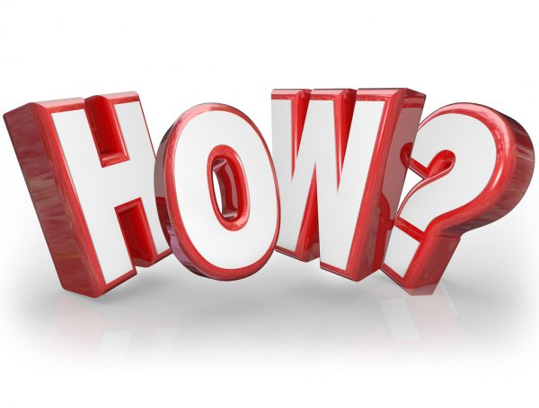
HOW IT WORKS?
Data Collection and Preprocessing: The system gathers a dataset of sign language gestures, capturing variations in lighting, backgrounds, and signing styles. This dataset is preprocessed to enhance its quality, normalize features, and prepare it for training.
Model Training: Machine learning algorithms, such as convolutional neural networks (CNNs) are trained on the preprocessed dataset to learn patterns and associations between hand movements and corresponding sign language gestures. Training involves optimizing the model's parameters to minimize prediction errors.

Slide 10
Feature Extraction: During real-time operation, the system extracts relevant features from input video feeds, such as the positions and movements of key points on the user's hands. These features are then fed into the trained model, which predicts the corresponding sign language gesture based on its learned patterns.
Gesture Recognition and Output: The system interprets the input features through the trained model, recognizing the sign language gesture being performed. The recognized gesture is then translated into a meaningful output, such as displaying the corresponding text or triggering a specific action, facilitating communication between individuals using sign language and those who may not understand it.

Slide 11
IMAGE PREPROCESSING
Image preprocessing is paramount to enhance the quality of input data and improve the model's performance. Initial steps involve resizing images to a consistent dimension, typically grayscale conversion to reduce computational complexity, and normalization to standardize pixel values.
Noise reduction techniques, such as Gaussian blurring, contribute to mitigating irrelevant details, while contrast enhancement and edge detection algorithms help emphasize important features like hand gestures.
Data augmentation, including rotation and flipping, diversifies the dataset, aiding the model in generalization. Extracting the Region of Interest (ROI) within an image refines focus on the relevant part, and leveraging pre-trained CNN models for feature extraction, through transfer learning, enhances the system's ability to recognize sign language gestures.

Slide 12
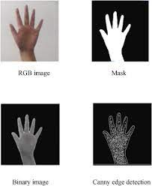
IMAGE PREPROCESSING

Slide 13
SEGMENTATION
Edge-based segmentation is a crucial facet of sign language detection systems, specifically employed to delineate the boundaries of hands making sign gestures within an image. Commonly used edge detection algorithms, such as the Canny edge detector or Sobel operator, pinpoint significant changes in intensity, effectively highlighting the edges of objects.
Following edge detection, a thresholding step converts the image into a binary representation, simplifying it to emphasize edges in white against a black background. Morphological operations, like dilation and erosion, refine the binary image, enhancing edge continuity.
Contour detection algorithms then identify and extract the contours outlining the hands. Subsequently, the system isolates the Region of Interest (ROI), focusing on the hands and providing a refined input for subsequent stages of the detection system.

Slide 14
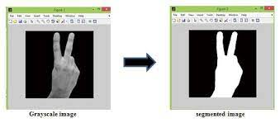
SEGMENTATION

Slide 15
FEATURE EXTRACTION
Feature extraction in a sign language detection system is a pivotal step aimed at distilling meaningful and distinctive information from raw input data, typically images or video frames capturing sign gestures.
These features play a crucial role in characterizing the visual elements of hand movements, enabling effective pattern recognition by machine learning algorithms. Spatial features encompass details about hand shape, size, and proportions, providing foundational insights into different signs.
Local Binary Pattern (LBP) in sign language detection encodes textural details by comparing pixel intensities with their neighbors, creating a binary pattern for each pixel. It is effective in capturing surface texture nuances in hand gestures.It enhances the accurate classification of sign language gestures. LBP is particularly advantageous for recognizing signs with varying hand poses and lighting scenarios.

Slide 16
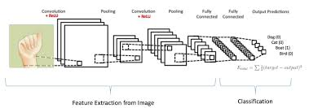
FEATURE EXTRACTION

Slide 17
CLASSIFICATION
Classification is a pivotal phase in sign language detection systems, wherein the system assigns specific labels to input data, typically representing distinct sign gestures. The process begins with the extraction of relevant features from the input, encompassing spatial information, texture descriptors, or other characteristics essential for capturing the unique elements of sign language expressions.
K-Nearest Neighbors (k-NN) in sign language detection classify gestures based on the majority class among their k nearest neighbors in the feature space. It operates on the principle of proximity, assigning labels to new instances based on the prevailing class among their closest neighbors.
The algorithm is simple and effective, making it suitable for sign language scenarios. The choice of 'k' and distance metric influences its performance. K-NN is particularly valuable for real-time sign language recognition due to its simplicity and adaptability.

Slide 18
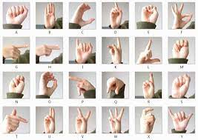
CLASSIFICATION

Slide 19
BLOCK DIAGRAM
PREPROCESSING
FEATURE EXTRACTION
CLASSIFICATION
TEXT GENERATION
INPUT SIGN IMAGE
SIGN DATABSE

Slide 20
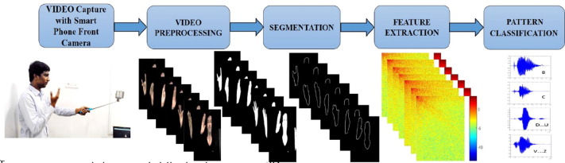
WORK FLOW:

Slide 21
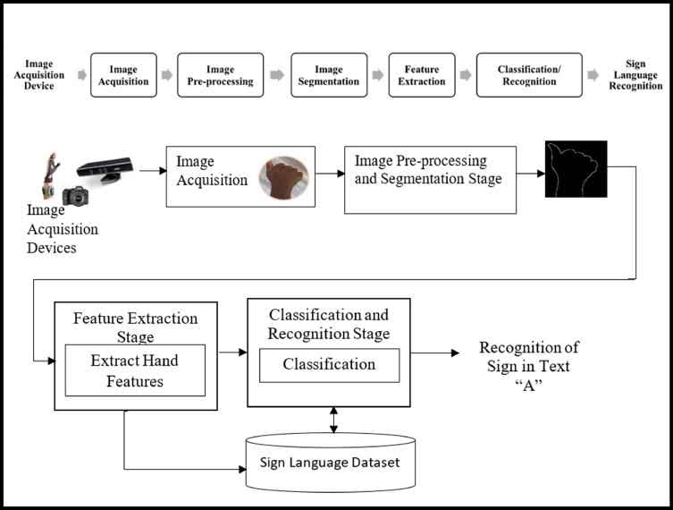
SIGN LANGUAGE RECOGNITION

Slide 22
TECHNOLOGICAL STACK
FRONT END | BACK END
HTML | FLASK(PYTHON)
CSS | DATABASE
JAVA SCRIPT
OPEN CV

Slide 23
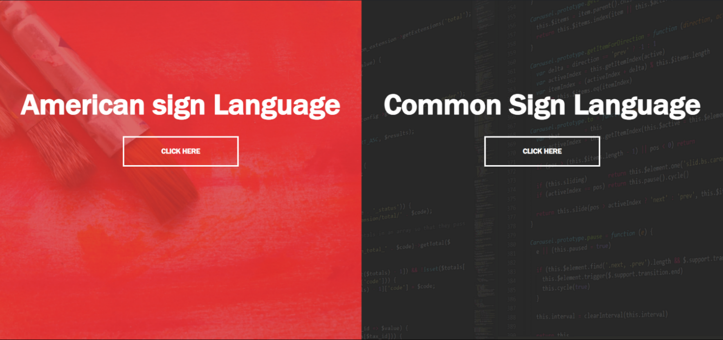
HOW IT LOOKS ?

Slide 24
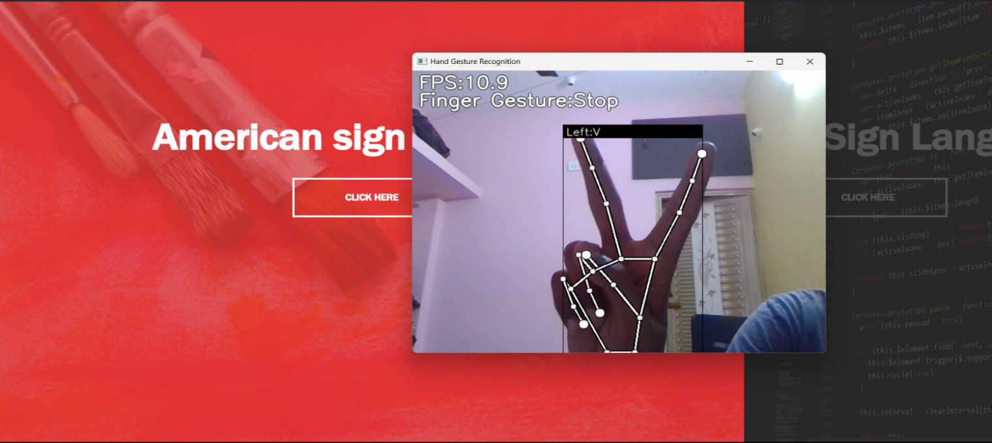
HOW IT LOOKS ?

Slide 25
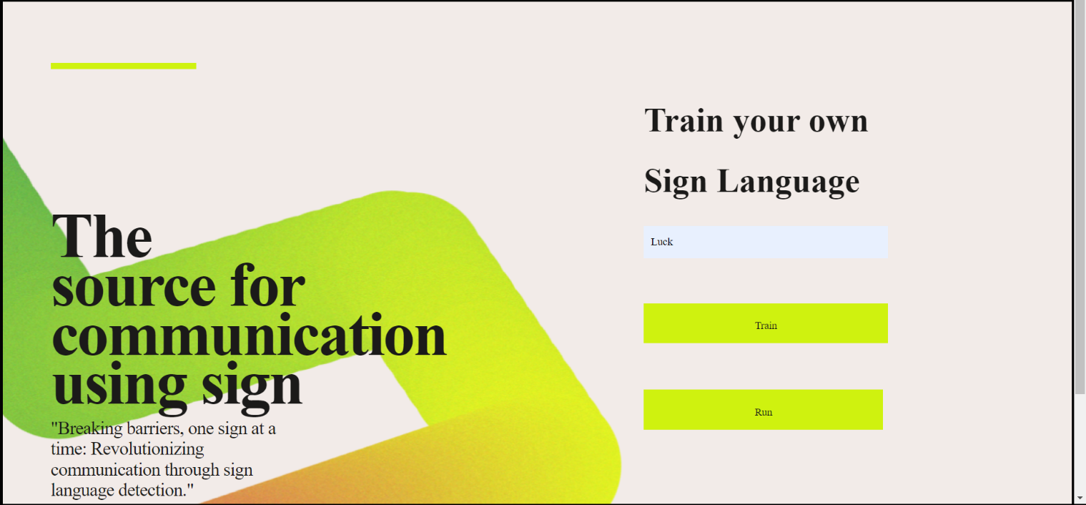
HOW IT LOOKS ?

Slide 26
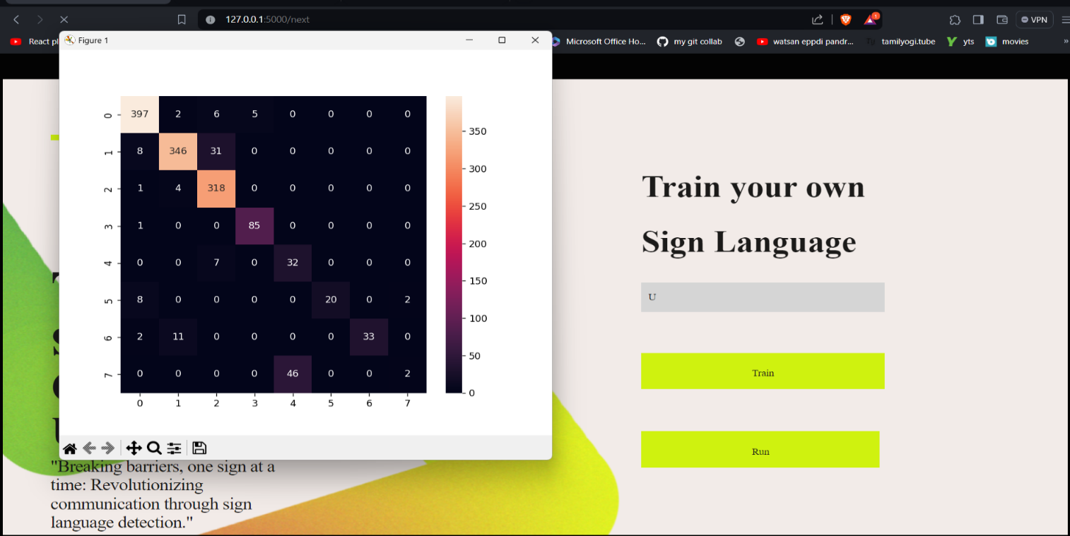
HOW IT LOOKS ?

Slide 27
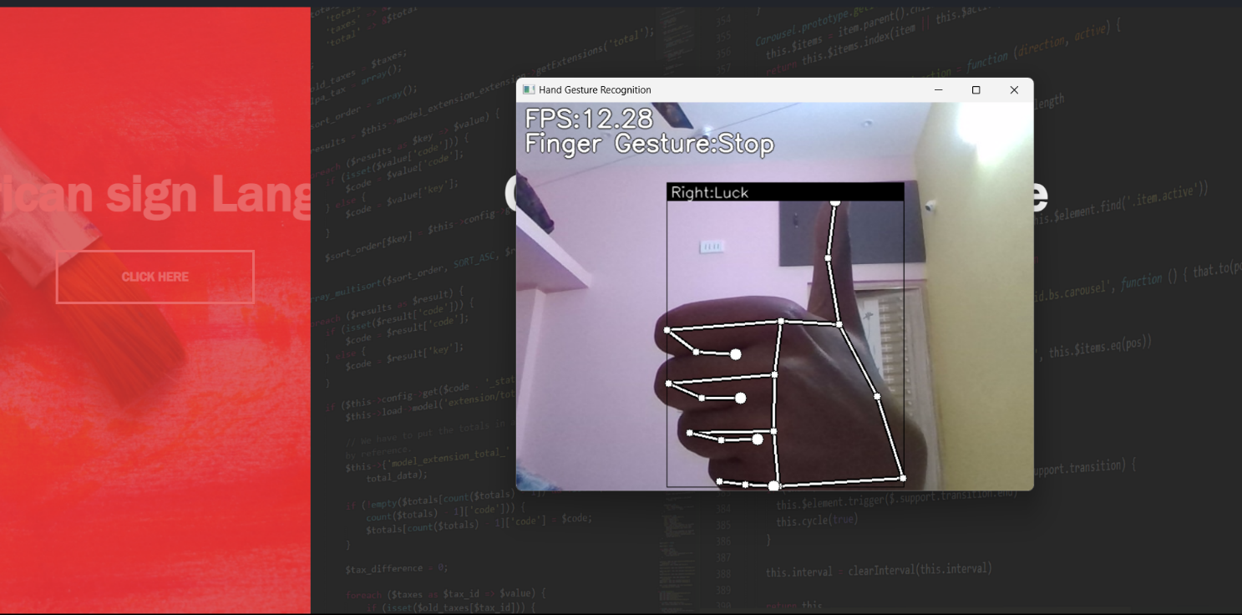
HOW IT LOOKS ?

Slide 28
JUSTIFICATION OF PROJECT
Real-time Interaction: Projection-based systems can offer real-time feedback, allowing users to receive immediate responses to their sign language gestures.
Accessibility: The primary justification is to enhance accessibility for individuals who use sign language as their primary mode of communication. Accurate in-time and out-time can be monitored
Communication Enhancement: a system that can detect and interpret sign language gestures, you enable users to convey complex messages and emotions through a medium that is native to them.
Empowerment: Providing individuals with hearing impairments the ability to use sign language in their interactions with technology empowers them to be more self-reliant and fully participate in various aspects of modern life.

Slide 29
REFERENCE
Zhaoyang Yang, Zhenmei Shi, Xiaoyong Shen, Yu-Wing Tai, “SFNet: Structured Feature Network for Continuous Sign Language Recognition”. arXiv preprint arXiv:1908.01341v1, 2019.
Ashish S. Nikam, Aarti G. Ambekar, “Sign Language Recognition Using Image Based Hand Gesture Recognition Techniques”, Online International Conference on Green Engineering and Technologies, 2016. Available doi: 10.1109/GET.2016.7916786.
G. Rajesh, X. Mercilin Raajini, K. Martin Sagayam, Hien Dang,”A statistical approach for high order epistasis interaction detection for prediction of diabetic macular edema”,Informatics in Medicine Unlocked, Volume 20,2020,100362,ISSN 2352-9148.
P. M. Ashok Kumar, Jeevan Babu Maddala, K. Martin Sagayam (2021) “Enhanced Facial Emotion Recognition by Optimal Descriptor Selection with Neural Network”, IETE Journal of Research, doi: 10.1080/03772063.2021.1902868

Slide 30

EXPECTED RESULTS
The expected results of a sign language detection system include accurate recognition of diverse gestures in real-time, fostering seamless and inclusive communication for individuals with hearing impairments.

